Slide 1
MGMT 658 – Mastering Agile and Scrum
Case 2 – Pearson’s Successmaker: Putting The Customer First In Transforming Product Development Processes
A Case Study By T. S. Raghu And Collin Sellman
Group 1 & 6
Yashwanth Nomula
Sumanth Bhuma
Venkata Ramya Maddineni
Ameya Desai
Priyaja Shankar Jena

Slide 2

Question 1
What challenges does Adams-Woodford face as he develops his five-year product roadmap?

Slide 3
SuccessMaker's Struggles
Pearson Plc - Global education company headquartered in London, United Kingdom
Operates worldwide with a diverse portfolio of educational products and services
Primary business units include North American Education, International Education, Professional, Financial Times, Interactive Data, and Penguin Publishing
SuccessMaker, Pearson's premier software product for math and reading skill improvement
The first upgrade took place before Mr. Woodford joined and that involved significant changes to the foundational technology of the product from an old client-server model to a new internet model
The product failed to meet internal sales goals and customer needs
A critical customer letter highlighted the need for a complete overhaul
SuccessMaker was facing declining popularity
Notes:
SuccessMaker was Pearson's premier software product for helping elementary and middle school students to improve their math and reading skills
SuccessMaker has seen many improvements over the years. However, a major upgrade in 2005 aimed to completely revamp the product.
The upgrade involved significant changes to the foundational technology of the product — from an older client-server model to a new Internet delivered model
While the intent of the new release was to address critical market issues, the reality was that it was missing the mark.
Despite investing $30 million, the new version didn't meet market expectations.
When Woodford joined Pearson in 2007, he noticed that even after six to eight months of launching the upgrade, it wasn't well received.
Woodford received letters from customers asking for a complete reengineering of the product.

Slide 4
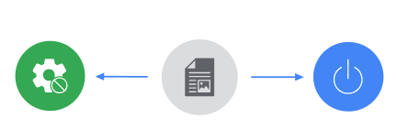
Initial Product Development Challenges
Disconnect in Deliverables
Significant Resource Allocation
A disconnect existed between the deliverables of the software development group and the actual needs of the customers
The Digital Learning unit invested substantial resources in developing a major upgrade to an educational software product
Much of the work was being done offshore in India
Notes:
Adams-Woodford faced a tough situation when he realized the product wasn't satisfying customers, even after updates.
SuccessMaker was a hit product that was losing its popularity and there were unsatisfied customers despite the update
His initial assessment revealed a fundamental issue: development team was making decisions about the product rather than product management.
There is a lack of direct communication between developers and customers which resulted in features missing the mark upon release.
The development team was using waterfall method, where they decide on everything early and stick to it.
This made it hard to talk about changes and made the product less adaptable.
And to make things even tougher, because of contracts, it was really hard or expensive to change anything about the product once they'd started making it. This made it even harder to give customers what they wanted.
Some of the work on the product was happening offshore in India, which made things even more confusing. The teams in different locations weren't talking well.

Slide 5
Transitioning Development Model - Agile
Off-shored waterfall model to on-shore Agile
Flash-Cut Transition to Agile Methodology
2 days training with Agile coach
Challenges Faced with Agile Adoption
Skepticism from Team Members
Debate between Scrum and Kanban
Maintaining Momentum
Notes:
First task of Woodford was to change the basic structure and culture of the organization
Even before the formal shift to Agile,
He transitioned all offshore software development to in-house by hiring several new software developers in Arizona.
As the agile methodology required close cooperation between team members on almost a daily basis.
Communication with the off-shore team had been a constant point of contention both with the Pearson team and their vendor.
The transition from waterfall to Agile methodology was executed as a sudden and complete change.
They followed a flash cut transition
Teams shifted from the waterfall process on a Friday to 100% Agile the following Monday.
As soon as the cut was made, training was delivered to all the software developers, QA engineers and product managers, detailing the new methodology and everyone's role within it.
They had an independent Agile coach to teach the team about the new development methodology
the teams spent 2 full days with the coach and the training was conducted in three phases
The major challenges faced by successmaker during the initial agile adoption were:
Skepticism from Team Members
Some team members are skeptical about Agile's compatibility with the current lifecycle phase of the product.
Debate between Scrum and Kanban
There's a debate between sticking with Scrum or switching to Kanban, leading to uncertainty in the implementation process.
Some influential members of the team proposed Scrum should be abandoned in favor of a Kanban system.
Woodford had been pushing for the Scrum method for a year. So, the idea of giving up on Scrum and trying something new didn't feel right to him.
Maintaining Momentum
As the novelty of new method faded away, development teams were reverting back to their old waterfall ways,
Specifically QA team was not comfortable with their new roles.
Resistance from certain groups and individuals not comfortable with Agile.

Slide 6
Challenges in Developing a Five-Year Product Roadmap
Adams-Woodford faces several challenges as he develops his five-year product roadmap
Shifting from
Waterfall to Agile
Reskilling and Team Reversion
Maintaining Team Motivation
Decision on Agile Methodology
Notes:
Adams-Woodford faces several challenges as he develops his five-year product roadmap
Shifting from Waterfall to Agile: Though Adams-Woodford has successfully implemented Scrum for the SuccessMaker team,
the content and curriculum teams are still using the Waterfall methodology.
This creates communication problems and makes it difficult to integrate the work between these teams.
Reskilling and Team Reversion: There's a risk of teams reverting to the Waterfall approaches they're familiar with.
Additionally, training the teams on estimating their velocity using story points and improving their ability to commit to release dates will require time and resources.
Maintaining Team Motivation: Keeping the teams inspired and motivated through a five-year roadmap can be challenging.
Adams-Woodford might need to consider cross-team deployment of team members to prevent monotony.
Decision on Agile Methodology: Adams-Woodford has to decide whether to stick with Scrum or switch to Kanban as suggested by his software development team.
While Scrum has shown success for SuccessMaker, Adams-Woodford is not as familiar with Kanban, making it difficult to measure success metrics

Slide 7
Key Considerations
Methodology Decision
Transitioning from Scrum to Kanban and potentially implementing Agile across the organization
Strategic Alignment
Aligning product development with long-term business goals and customer needs
Planning Horizon
Balancing the need for a five-year roadmap with the uncertainty of the market and technology
Pockets of Agile Adoption
Addressing resistance to change and ensuring successful Agile implementation across different teams
Notes:
One of the primary hurdles Adams-Woodford faces is optimizing communication and collaboration between the marketing and product development teams. This involves aligning the organizational structure, culture, and processes to ensure effective roadmap development.
Methodology:
Adams-Woodford must make a crucial decision regarding the choice of methodology—whether to stick with Scrum, switch to Kanban, or implement Agile across the organization. Each methodology has its strengths and weaknesses, and the choice should reflect the specific needs of the product and teams.
Strategy:
The roadmap needs to align closely with the company's long-term business objectives and the evolving needs of the customers. Both marketing and development teams need to share a common understanding of the product's purpose and target audience to ensure successful execution
Planning Horizon:
While a five-year roadmap provides a sense of direction, it's essential to acknowledge the dynamic nature of the technology and market landscapes. The roadmap must remain flexible enough to adapt to changes and disruptions along the way.
Pockets of Agile Adoption:
Despite the benefits of Agile methodologies, Some teams may resist transitioning to Agile methodologies.
This resistance could stem from various factors such as a reluctance to change, skepticism about Agile's effectiveness, or concerns about disruptions to established workflows
Adams-Woodford needs to address these concerns and ensure successful Agile implementation across all departments.

Slide 8
Question 2
How do product and software development methodologies influence a firm’s ability to respond to market demands?

Slide 9

Impact of Product and Software Development Methodologies
Product and software development methodologies play a critical role in how a company reacts to the ever-changing whims of the market. The right approach can mean the difference between staying ahead of the curve and getting blindsided by customer needs.
Remember Blackberry and Nokia?

Slide 10





Influential Factors
Customer Focus
Flexible
Speed
Innovation
Reduced Risk
Notes:
Customer Focus: Agile methodologies emphasize close collaboration with customers. User stories and feedback are constantly integrated into the development process, ensuring the product stays relevant to market demands. Waterfall often prioritizes internal requirements over customer needs, leading to products that miss the mark.
Flexibility and Speed: Agile methodologies like Scrum and Kanban prioritize short development cycles (sprints) and continuous feedback loops. This allows firms to adapt quickly to changing customer needs and market trends. Traditional methodologies like Waterfall, with their rigid structure and lengthy planning phases, struggle with such rapid adaptation.
Innovation: Agile methodologies encourage experimentation and rapid prototyping. This fosters a culture of innovation, allowing firms to explore new ideas and features more readily. Traditional methodologies can stifle innovation due to their focus on predefined specifications and risk aversion.
Reduced Risk: By delivering features in smaller chunks, agile methodologies allow companies to identify and address problems early on. This reduces the risk of investing heavily in features that ultimately don't meet market needs. Waterfall methods, with their later-stage testing, can lead to expensive rework if major issues are discovered after significant development is complete

Slide 11





Learnings from Tech Giants
Waterfall or Agile, We Don't Choose Sides, We Adapt Our Stride
Notes:
We have checked on what kind of strategies that are being used for project management in tech giants like Apple, Google, Amazon and few other organizations. One thing in common – They don’t follow one methodology – they change as per their needs and requirements of the teams. For example – apple use agile methodology to build iphones, ipads to keep understanding user needs and adapt to market. When in case of core technologies like chip design etc., they would prefer a waterfall approach. It is similar to few lines quoted in the article that few teams still follow waterfall while the development team started following Agile.

Slide 12
Takeaways from Clayton Christensen's Model
Dedicated Innovation Teams
Customer Insights
Prioritization and Resource Allocation
Metrics and Measurement
Notes:
This Disruptive Innovation framework helps identify opportunities for disruptive innovation by focusing on underserved customer segments or unmet needs. By analyzing the market through this lens, Adams-Woodford could identify areas for breakthrough innovations alongside incremental improvements.
Dedicated Innovation Teams: Forming separate teams focused on disruptive innovation can free up the core development team from the pressure of constant iteration. These teams could explore new technologies and business models with a longer-term perspective.
Customer Insights: Incorporating customer feedback not just for immediate improvements but also for uncovering unmet needs and potential disruptive opportunities.
Prioritization and Resource Allocation: Allocate resources strategically, balancing incremental improvements with disruptive innovation efforts. This might involve setting specific goals and timelines for both types of projects.
Metrics and Measurement: Develop metrics to track the progress and success of disruptive innovation initiatives. These could include Number of new disruptive ideas generated, User engagement with disruptive prototypes, Market potential for disruptive concepts

Slide 13
Question 3
What benefits did Pearson realize in making the shift from a Waterfall process to an Agile one? What downsides might be associated with such a shift? What firm or market circumstances are more likely to benefit from a Waterfall or Agile methodology?

Slide 14
Agile Transition at Pearson: Upsides
Reduced Code Base Size
Increased Feature Development
Positive Reception from Clients
Reduced Development Team Size
Minimal Formal Documentation
Notes:
Reduced code base: The code base for SuccessMaker was cut in half after transitioning to Agile. This indicates increased efficiency and optimization in development practices, resulting in a streamlined and more manageable code base. Increased Feature Development: Even though the amount of code for SuccessMaker got smaller, the number of features it offered increased by up to 75%. This is probably because Agile methods helped Pearson make things quicker, delivering more stuff to customers faster.
Positive Reception from Clients:The clients really liked the new features made using Agile methods. This means that Agile helped Pearson to make products that fit better with what customers want, making the product experience more enjoyable
Reduced Development Team Size: The development team size decreased by at least a third, primarily by eliminating off-shore development teams. This reduction in team size indicates improved efficiency and productivity achieved through Agile practices, where smaller, cross-functional teams can deliver high-quality results. Minimal Formal Documentation: Agile minimized the need for extensive documentation, replacing lengthy requirements documents with short, user-centric stories written on index cards. This streamlined documentation process saved time and resources while maintaining focus on delivering value to customers.

Slide 15
Challenges of Agile Transition: Downsides
Resistance to Change
Blurred Responsibilities
Decreased Velocity
Management Challenges
Incomplete Adoption Across Teams
Notes:
Resistance to change:Some team members, especially those in roles like Quality Assurance (QA), had a hard time getting used to the new Agile way of working. They found it difficult to do their jobs without the thorough documentation they were used to in the Waterfall method.
Blurred Responsibilities: In Agile, it's not always clear who is responsible for what tasks, like between developers and QA engineers. This confusion can make team members feel unsure about who's accountable for what, causing problems.
Decreased Velocity: Switching to Agile at first made developers work slower, especially when teams started going back to their old waterfall methods. This drop in productivity made them think about changing from Scrum to Kanban to fix the problem.
Management Challenges:Managers, whether of developers or QA engineers, sometimes found it hard to adjust to their new jobs in Agile teams. They might struggle to let go of control and let teams manage themselves, which can make Agile less effective. Incomplete Adoption Across Teams:While the software development team successfully transitioned to Agile, other cross-functional teams, such as the content team, continued to use a waterfall approach. This lack of uniformity can create challenges in coordination and collaboration across different departments.

Slide 16
Choosing the Right Methodology: Waterfall vs. Agile
Waterfall Methodology: Ideal for projects with well-defined requirements, strict regulatory needs, and long-term stability.
Agile Methodology: Suited for projects with rapidly changing requirements, innovation-driven initiatives, and customer-centric focus.
Factors Influencing Choice: Consider project scope, regulatory requirements, technology stability, and market dynamics when selecting the methodology.
Notes:
Waterfall Methodology:
Big, Steady Projects: Waterfall is good for projects with clear needs and steady plans, where changes aren't expected often.
Strict Industries: In industries with lots of rules, like healthcare or aerospace, Waterfall's focus on careful documentation can be helpful.
Fixed Requirements: It's useful for projects where the needs are unlikely to change much as the project goes on.
Agile Methodology:
Changing Requirements: Agile works well when needs are expected to change or aren't fully known upfront. It's flexible and can adapt as things evolve.
Fast-paced Settings: In industries where things change quickly, like tech, Agile can deliver results faster and respond to new challenges.
Creative Projects: Agile encourages trying new things and working closely together, so it's good for projects that need lots of brainstorming and experimenting.
Client Involvement: Agile keeps clients involved and gets their feedback often, making it great for projects where the client's input is key to success.

Slide 17
Question 4
What are some of the things Adams-Woodford should consider as he evaluates whether to continue to focus on the SuccessMaker product versus becoming involved in a company-wide Agile initiative? What approach should Adams-Woodford pursue? How might he optimize this approach?

Slide 18
Considerations for Adams-Woodford
Strategic Alignment
Resource Allocation
Market Demand
Product Development Lifecycle
Team's Agile Maturity
Scalability of Agile Practices
Customer Feedback
Notes:
1. Adams-Woodford should evaluate how each option aligns with Pearson's strategic goals. The company's commitment to transforming its product development processes for digital channels is a key element of its growth strategy.
2. He must assess whether he has the necessary resources, including time and personnel, to lead a company-wide Agile transformation while maintaining the quality and progress of the SuccessMaker product.
3. Understanding the market demand for SuccessMaker is crucial. If the product is at a critical juncture where focused attention could significantly enhance its market position, it may justify continued emphasis on the product.
4. The stage of the SuccessMaker product in its lifecycle should be considered. If the product is mature and requires less innovation, it might be an opportunity to shift focus to broader Agile initiatives.
5. The current Agile maturity of the SuccessMaker team and other teams within Pearson should be assessed. If the SuccessMaker team is well-versed in Agile, it might be beneficial to leverage their experience to assist other teams.
6. Adams-Woodford should consider whether the Agile practices implemented within the SuccessMaker team can be effectively scaled to other teams and products within Pearson.
7. The feedback from customers regarding the SuccessMaker product and its development process should inform the decision. If customers are satisfied with the Agile transformation of SuccessMaker, it could serve as a model for other products.

Slide 19
Recommended Approach
Adams-Woodford might pursue a hybrid approach
Continue SuccessMaker Focus
Maintain focus on the SuccessMaker to ensure it meets market demands and achieves its strategic objectives
Gradual Agile Transformation
Begin laying the groundwork for company-wide Agile initiative by sharing best practices and success stories from Agile transformation

Slide 20
Optimizing the Approach
Delegate Responsibilities: Establish a leadership team to manage SuccessMaker's day-to-day operations, freeing up time for focusing on the Agile initiative.
Pilot Agile Expansion: Start with a pilot program to introduce Agile practices to other teams within Pearson, using the SuccessMaker team as a case study
Measure Impact: Utilize metrics and KPIs to measure the impact of Agile practices on product development, customer satisfaction, and business outcomes
Foster Agile Culture: Promote an Agile mindset across Pearson by organizing workshops and training sessions, emphasizing the benefits of Agile methodologies
Stakeholder Engagement: Engage with key stakeholders to gain support for the Agile transformation and ensure alignment with business objective

Slide 21
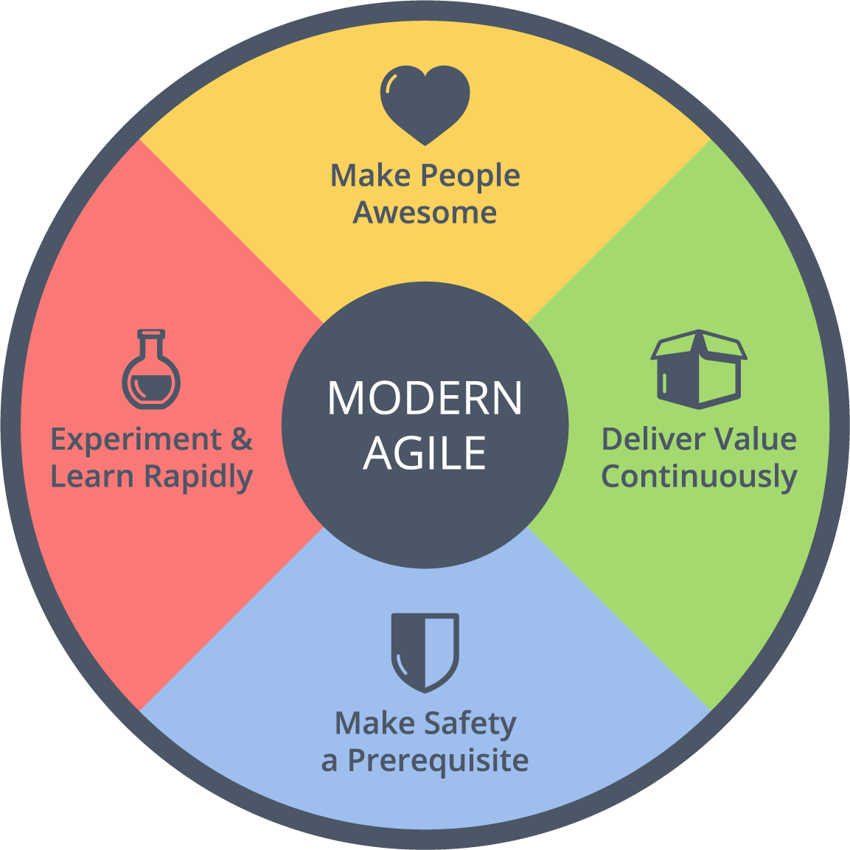
To Conclude
Adams-Woodford does not necessarily have to pursue just one Agile approach.
A hybrid approach that enables the enhancement of SuccessMaker while promoting Agile practices company-wide could best balance immediate product needs with long-term strategic transformation.
This Photo by Unknown Author is licensed under CC BY-SA

Slide 22
Question 5
Within the SuccessMaker team, should Adams-Woodford agree to follow the recommendations from his developers to move from Scrum to Kanban? Should he also push to move all the remaining teams (the content / curriculum team) to Scrum or Kanban? What metrics should he use to evaluate his decisions?

Slide 23
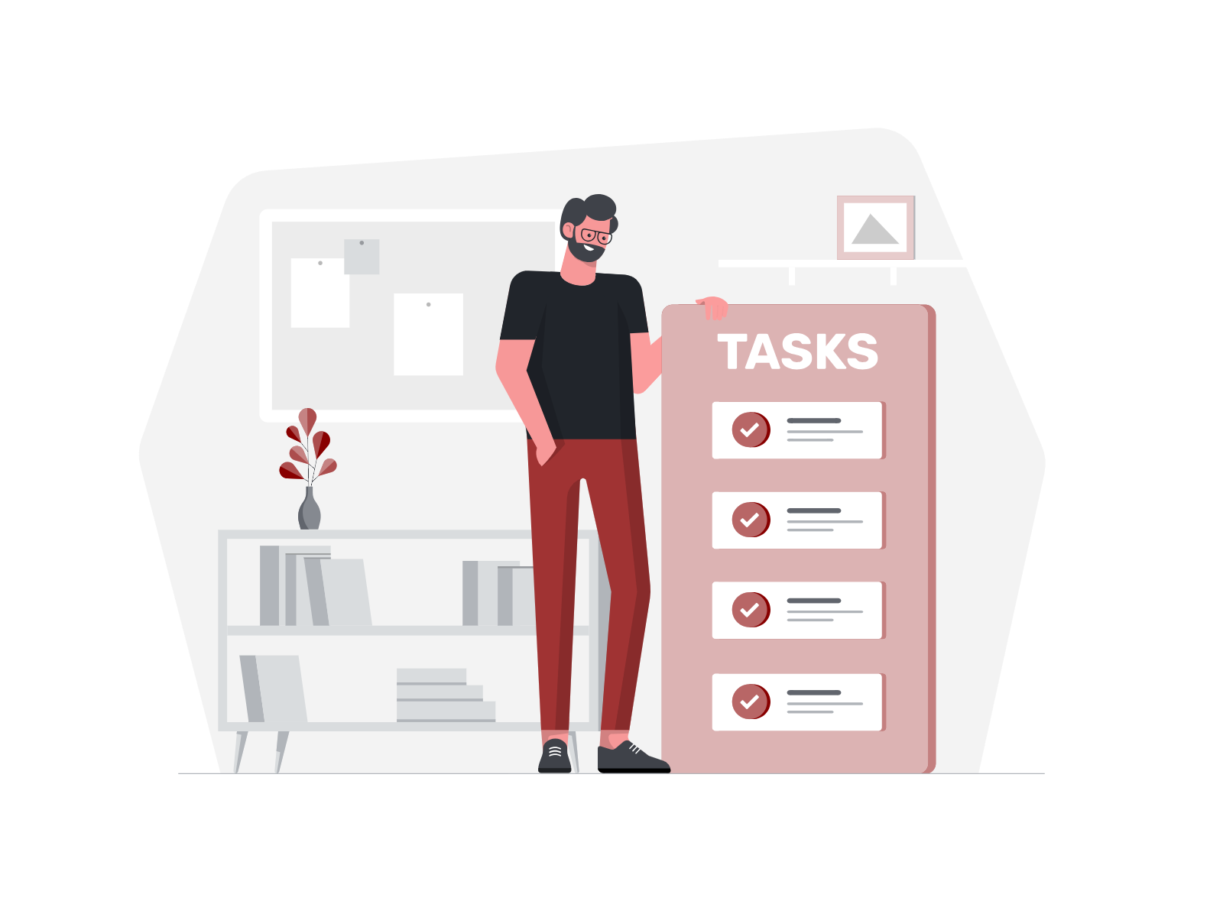
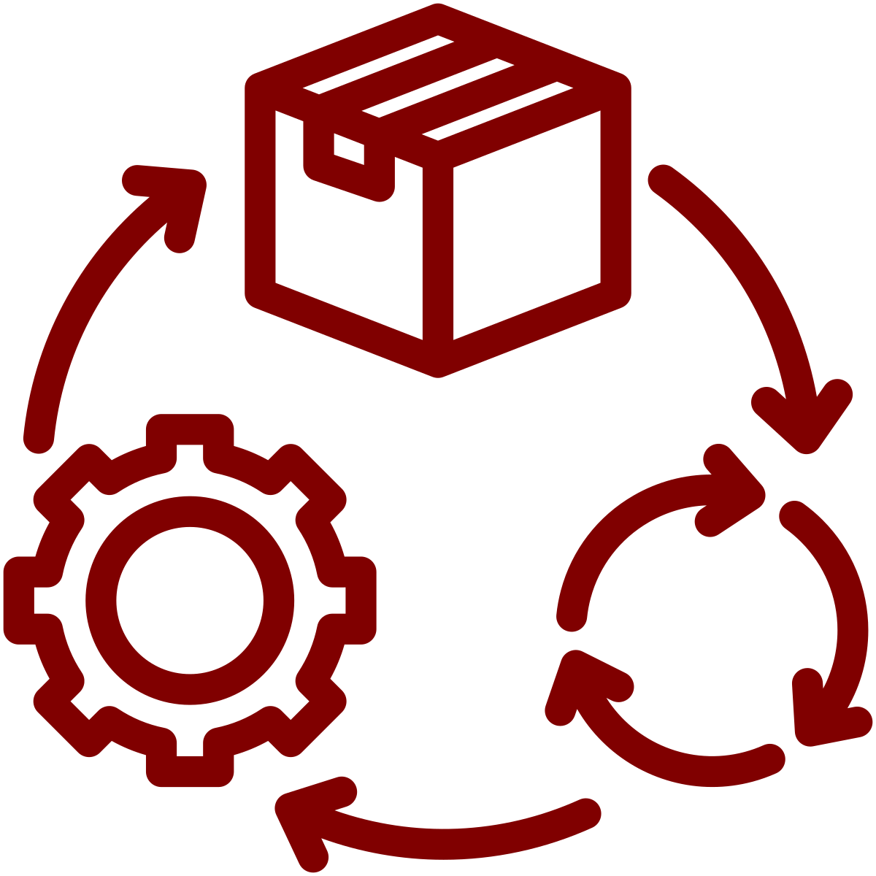
Should Adams-Woodford transition the SuccessMaker team from Scrum to Kanban?
PROS
Lifecycle Phase Mismatch
Improving Productivity
Notes:
Addressing Lifecycle Phase Mismatch: The developers' observation that Scrum might not fit the current lifecycle phase of the product suggests that Kanban, with its focus on continuous delivery and managing work in progress, might be more aligned with the team's needs.
Improving Productivity: Given the reported downtrend in productivity with Scrum, Kanban's flexibility and emphasis on workflow optimization could rejuvenate the team's efficiency.

Slide 24


Should Adams-Woodford transition the SuccessMaker team from Scrum to Kanban?
CONS
Disruption and Skepticism
Learning Curve
Notes:
Disruption and Skepticism: Adams-Woodford has been a strong advocate for Scrum, and moving away from it might cause skepticism and disruption. The transition could be perceived as a sign of indecisiveness or lack of direction.
Learning Curve: Switching methodologies involves a learning curve and adjustment period, which could temporarily affect the team's performance.

Slide 25

Extending Agile to the Content/Curriculum Team
Notes:
Agile methodologies emphasize adaptability, customer collaboration, and early delivery of value—principles that can benefit any creative or development process, including content and curriculum development. Extending Agile methodologies to these areas could foster better collaboration and alignment with the software development process, leading to more coherent and customer-aligned product offerings.

Slide 26





Metrics for Evaluating Decisions
Customer Satisfaction
Delivery Timeliness
Productivity Metrics
Team Morale and Retention
Quality Metrics
Notes:
Customer Satisfaction: Feedback from customers on the responsiveness to their needs and the quality of updates or new releases.
Delivery Timeliness: The frequency and reliability of product releases or updates.
Productivity Metrics: Measures such as story points completed (for Scrum) or lead time and throughput (for Kanban) can indicate the efficiency of the development process.
Team Morale and Retention: Employee satisfaction and turnover rates can be indirect indicators of the success of a methodology transition.
Quality Metrics: Defect rates and the severity of issues found in production can help gauge the impact of the methodology on the product's quality.

Slide 27


Can Scrum and Kanban Coexist?
Hybrid Approach
Scrum Structure
Kanban Principles
Notes:
A hybrid approach, Srumban, which combines the structure of Scrum with the flow-based principles of Kanban, could offer a middle ground.
This approach allows for the planning and predictability of Scrum while adopting Kanban's flexibility and emphasis on managing work in progress.
Such a hybrid method could cater to varying needs within the SuccessMaker team and across other teams, accommodating different phases of product development and diverse team dynamics.
Conclusion: Transitioning from scrum to kanban is not really a change in methodology but rather a deeper dive into agile principles to get the maximum out of their product.
The main goals should always be focused around the customer trying to deliver maximum value, fostering team collaboration, and be flexible to adapt to changing needs. Integrating Agile principles more broadly across teams, while respecting each team's unique context, can drive a coherent and dynamic approach to product development at Pearson.

Slide 28
Q&A

